Slide 1
ENEZA Data Science Capability and Tools for Health in East Africa DS-I Africa Networking Exchange

Slide 2
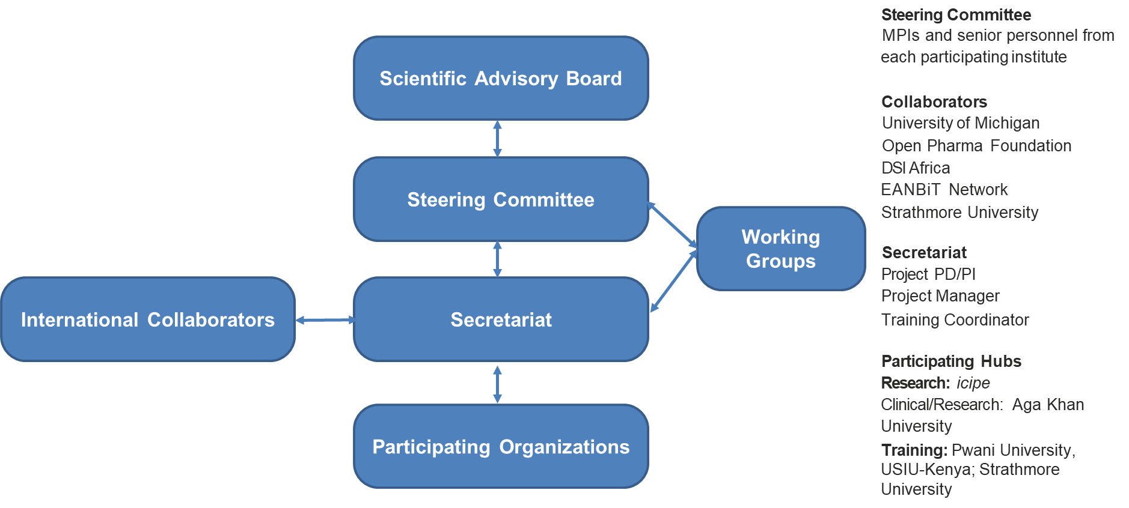
Structure of ENEZA

Slide 3
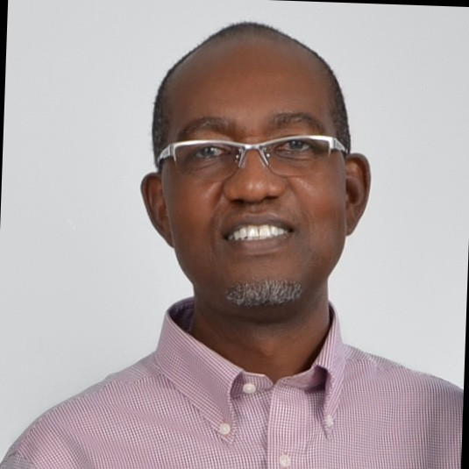
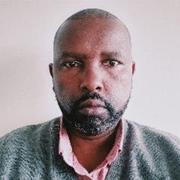
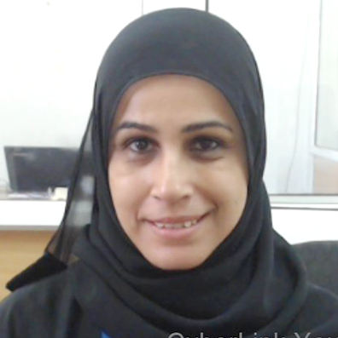
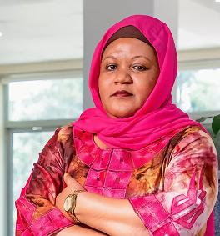
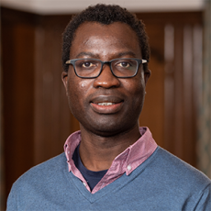
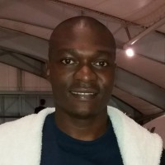
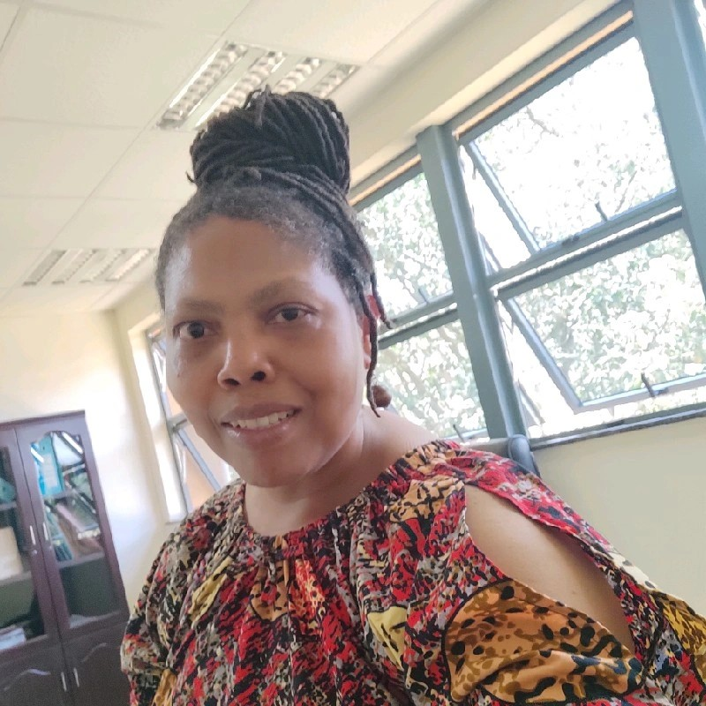
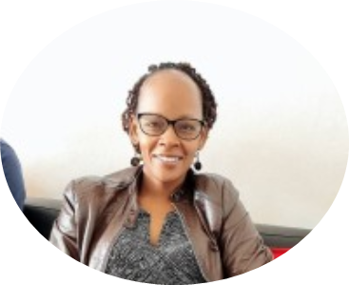

ENEZA Secretariat and Partners
Suhaila Omar Hashim, PhD
MSc. Bioinformatics Programme Co-ordinator,, Pwani University Biosciences Research Centre
Daniel Masiga, PhD
PI-Program Director, Principal and Head of Human Health Theme at International Centre of Insect Physiology and Ecology (icipe)
Amina Abubakar, PhD
CO-PI, Professor, Aga Khan University, Institute for Human Development
Anthony K. Ngugi, PhD
Co-PI, Associate Professor of Epidemiology & Population Health
Audrey Mbogho, PhD
Associate Professor of Machine Learning, USIU-Africa
Geoffrey Siwo, PhD
Research Assistant Professor, Department of Learning Health Sciences, University of Michigan
Kennedy Senagi, PhD
Training Coordinator, Data Science, Machine Learning, Artificial Intelligence, Software Engineer and Research Expert

Slide 4
GOAL: Empower clinicians, health personnel, health researchers, and data science researchers with data and open science skills and tools to turn data into meaningful insights for better health
Aim 1
Develop a collaborative platform for promoting and strengthening data science for health training and career development
Aim 2
Build awareness of the need for data science for health through engagement among
stakeholders to grow the application of data science tools in clinical settings
Aim 3
Design a training model that combines short courses, hackathons, and mentorship programs to build
capacity for clinicians, researchers, trainers, and trainees

Slide 5
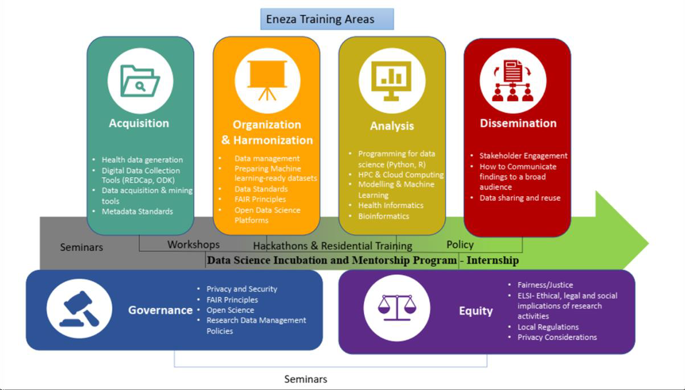
ENEZA - Training Areas

Slide 6
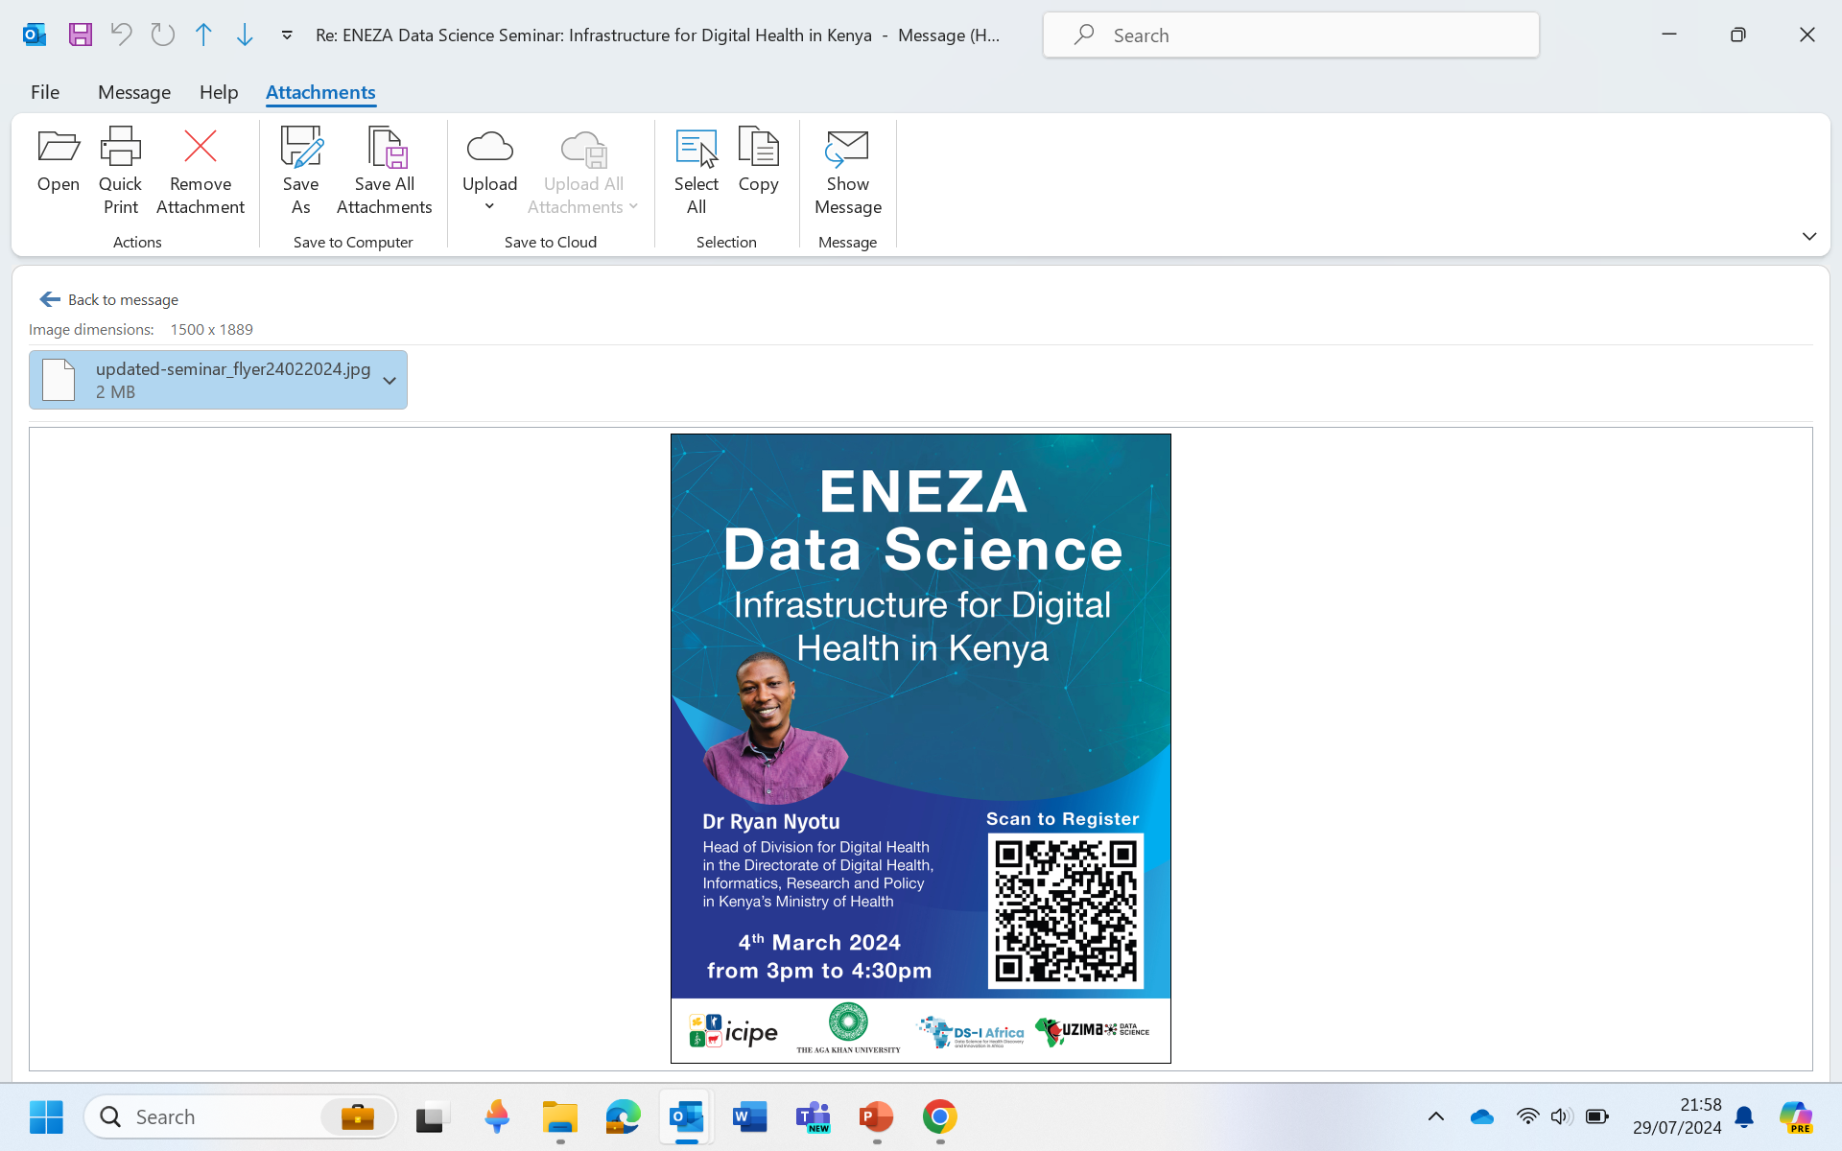
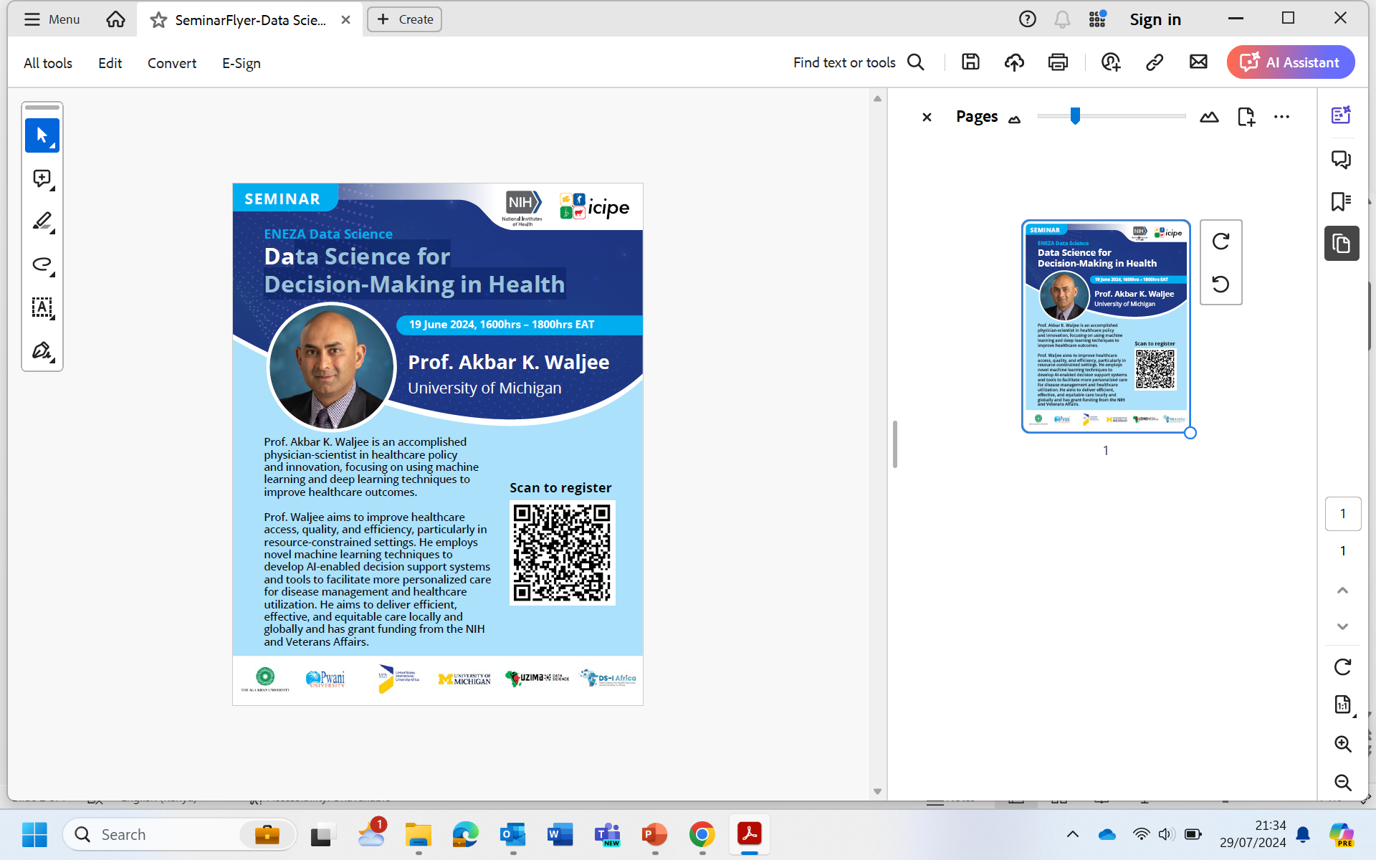
Seminars
Current engagements
Seminars 1: Infrastructure for Digital Health in Kenya: 75 participants drawn from 25 institutions based in 6 countries
Seminars 2: Science for Decision-making in Health. 77 participants drawn from 25 institutions based in 9 countries Data Science for Decision-making in Health: 77 participants from 35 institutions

Slide 7
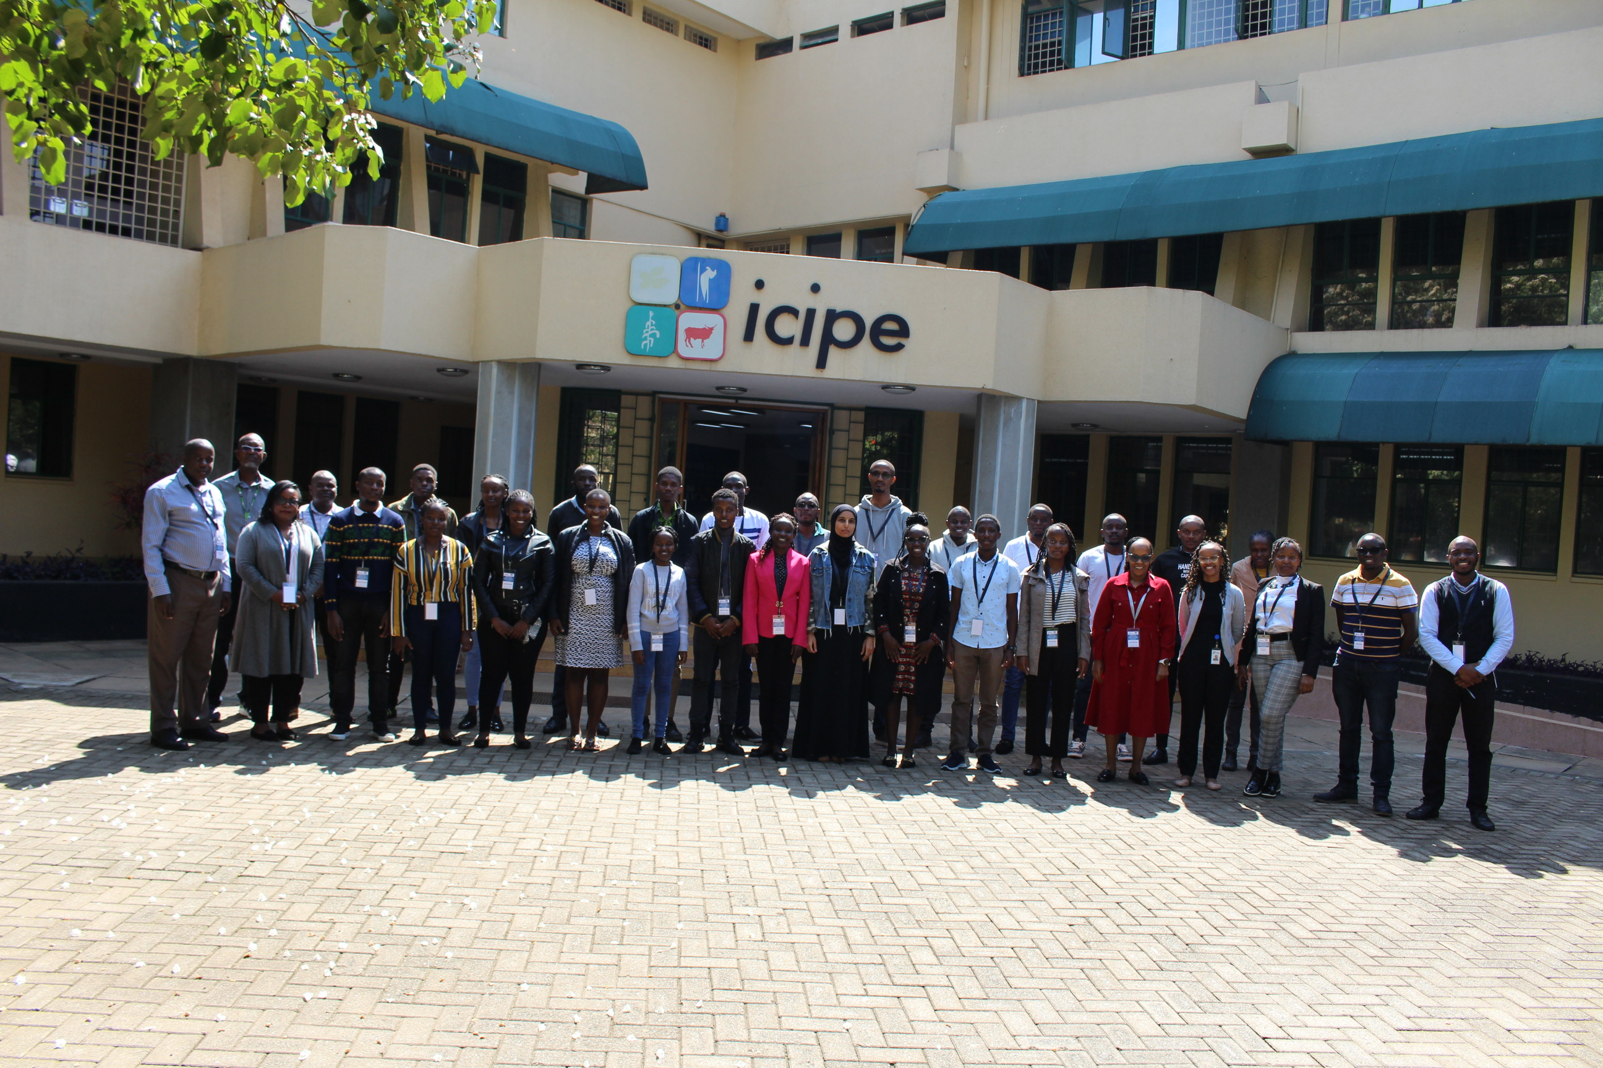
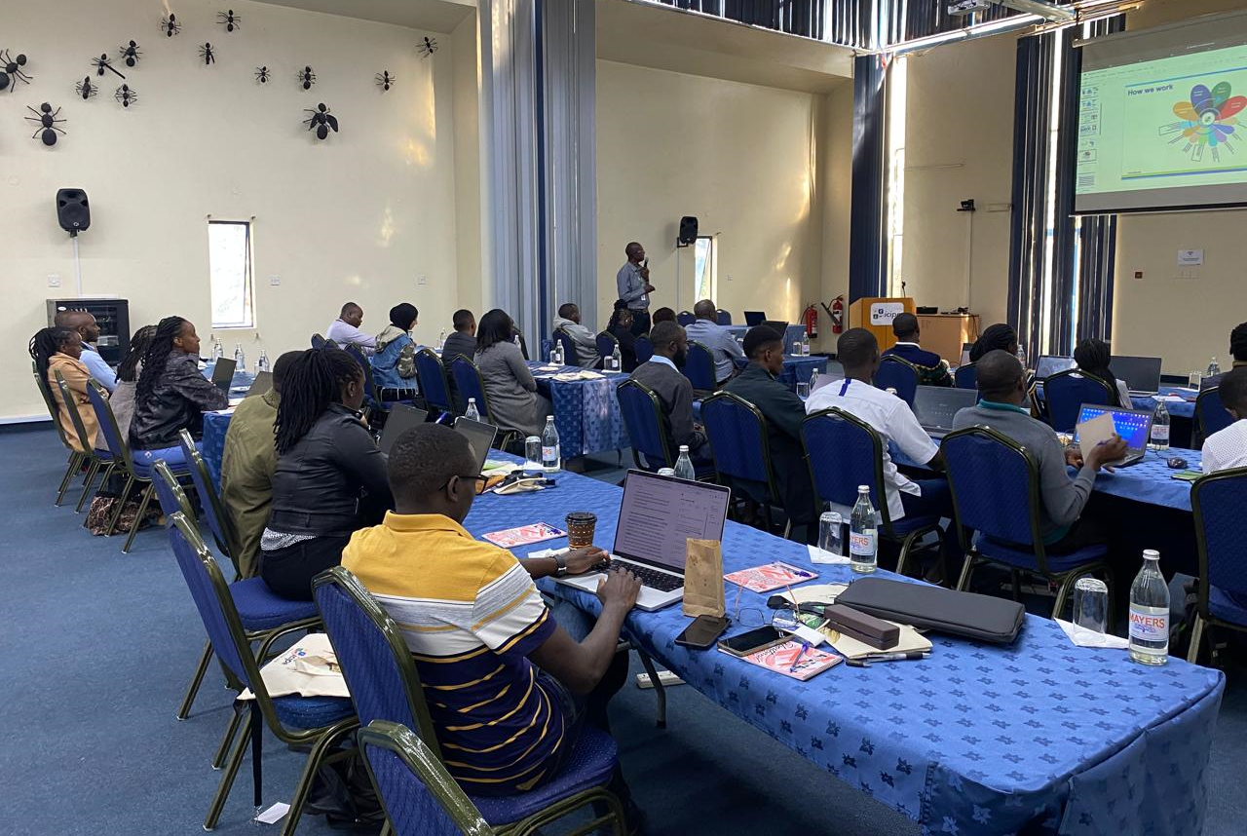
Residential Training
More than 30 participants were taken through a 5 weeks residential training in application of data science and machine learning in health
Inhouse Mini – projects undertaken
A spatial machine learning model for early preparedness of visceral leishmaniasis disease in Turkana County in Kenya
Biological aging based using human's characteristics such as DNA methylation, cell senescence, telomere length, etc.
Using natural language processing to understand legislative gaps in diseases in Kenya

Slide 8

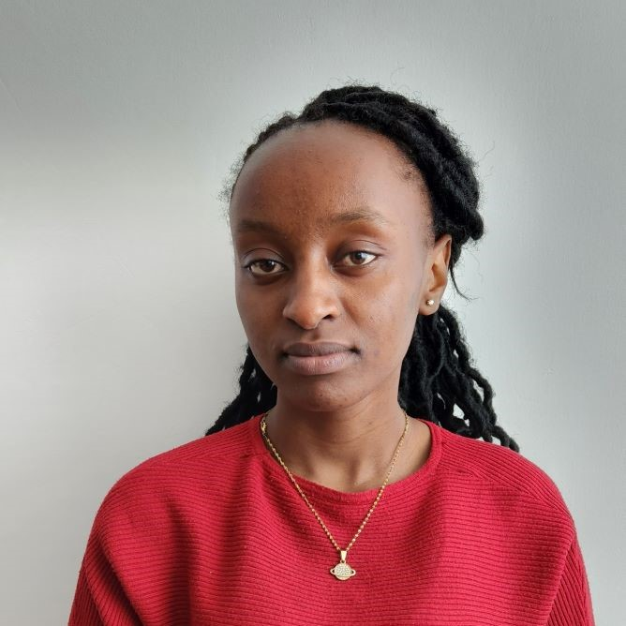
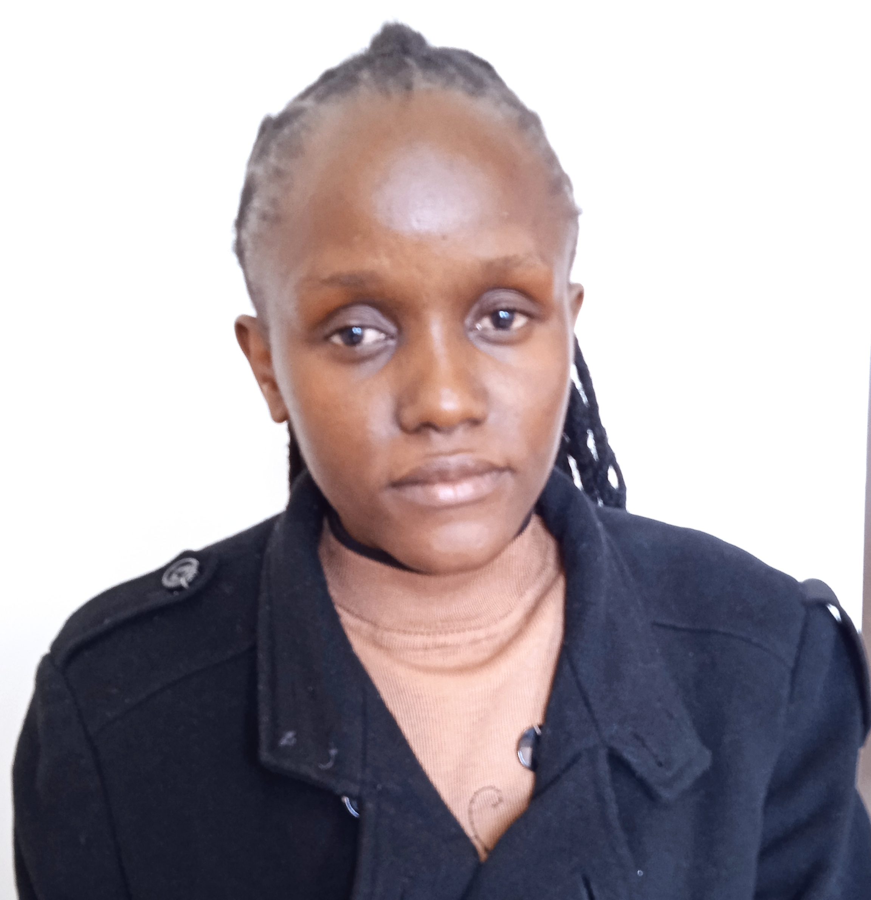
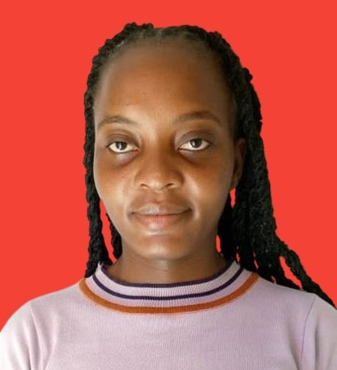
Internships
4 Interns currently being trained on cutting edge data science techniques and their applications to various domains in the health sectors.
Clinician training
One Week training for Clinician and other health practitioners in Kenya scheduled for August 12-16, 2024
Purity Njenga
BSc. Medical Biotechnology
Esther Njuguna
BSc. Clinical Medicine and Community Health
Peninah Safari
BSc. Mathematics and Statistics
Barrington Gesimba,
BSc. Applied Computer Science

Slide 9
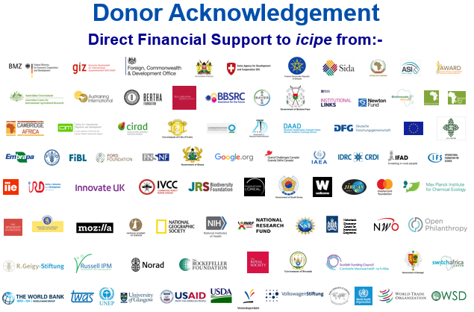

Slide 10

Thank you
International Centre of Insect Physiology and Ecology
P.O. Box 30772-00100, Nairobi, Kenya
Tel: +254 (20) 8632000
E-mail: icipe@icipe.org
Website: www.icipe.org
facebook.com/icipe.insects/icipe
twitter.com/icipe
linkedin.com/company/icipe
Support icipe: www.icipe.org/support-icipe

